Slide 1

DAVIDS COFFEA

Slide 2


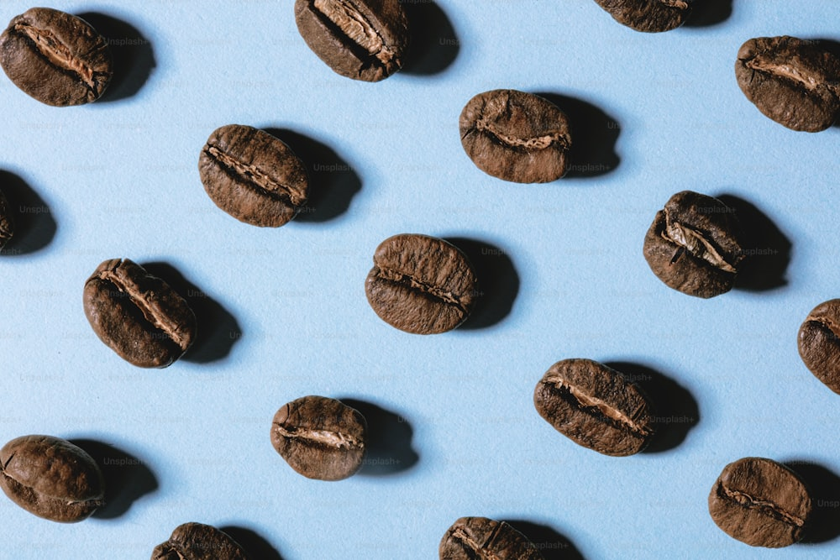
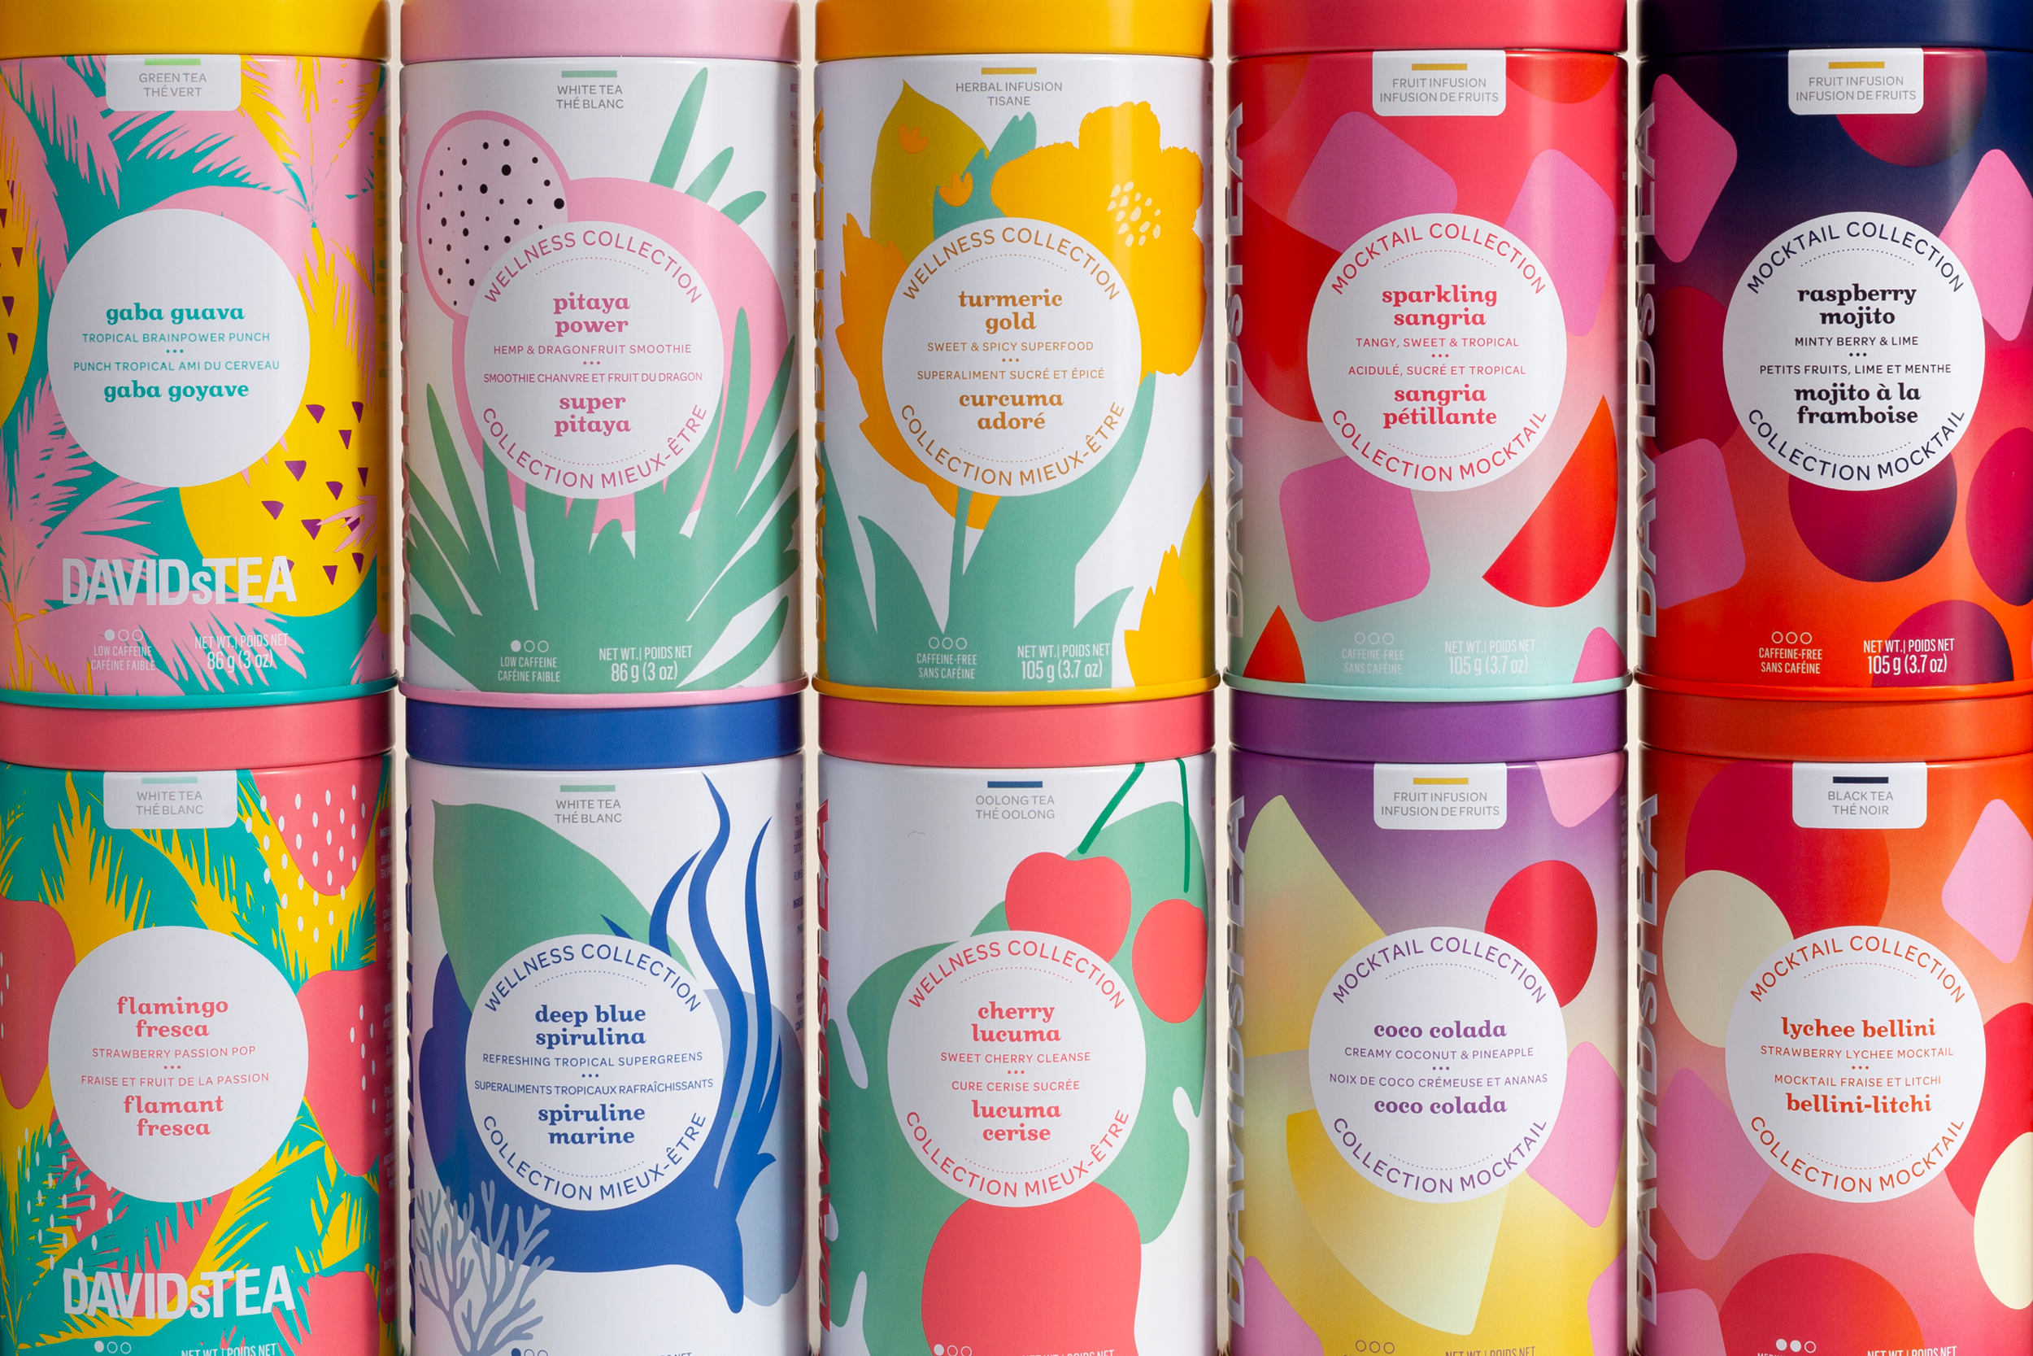
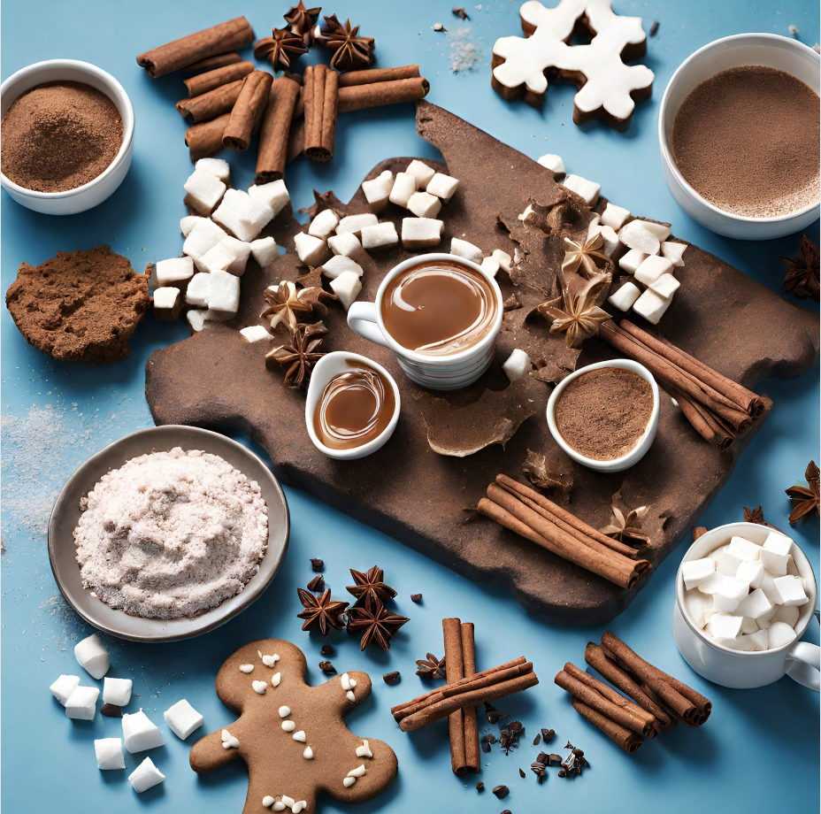



DAVID’s TEA

Slide 3
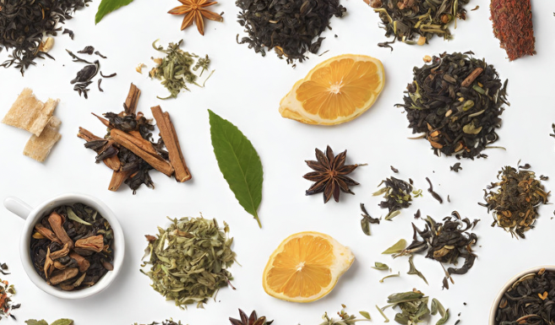
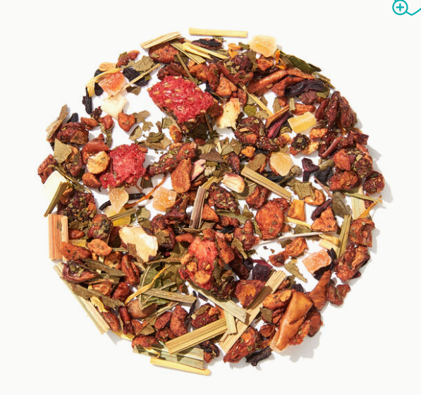
DAVID’s Coffea
DAVID’s COFEA

Slide 4
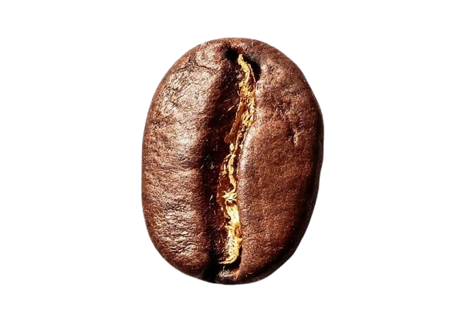
DAVID’s Tea
Serving Canada Since 2008
DAVID’s COFEA

Slide 5
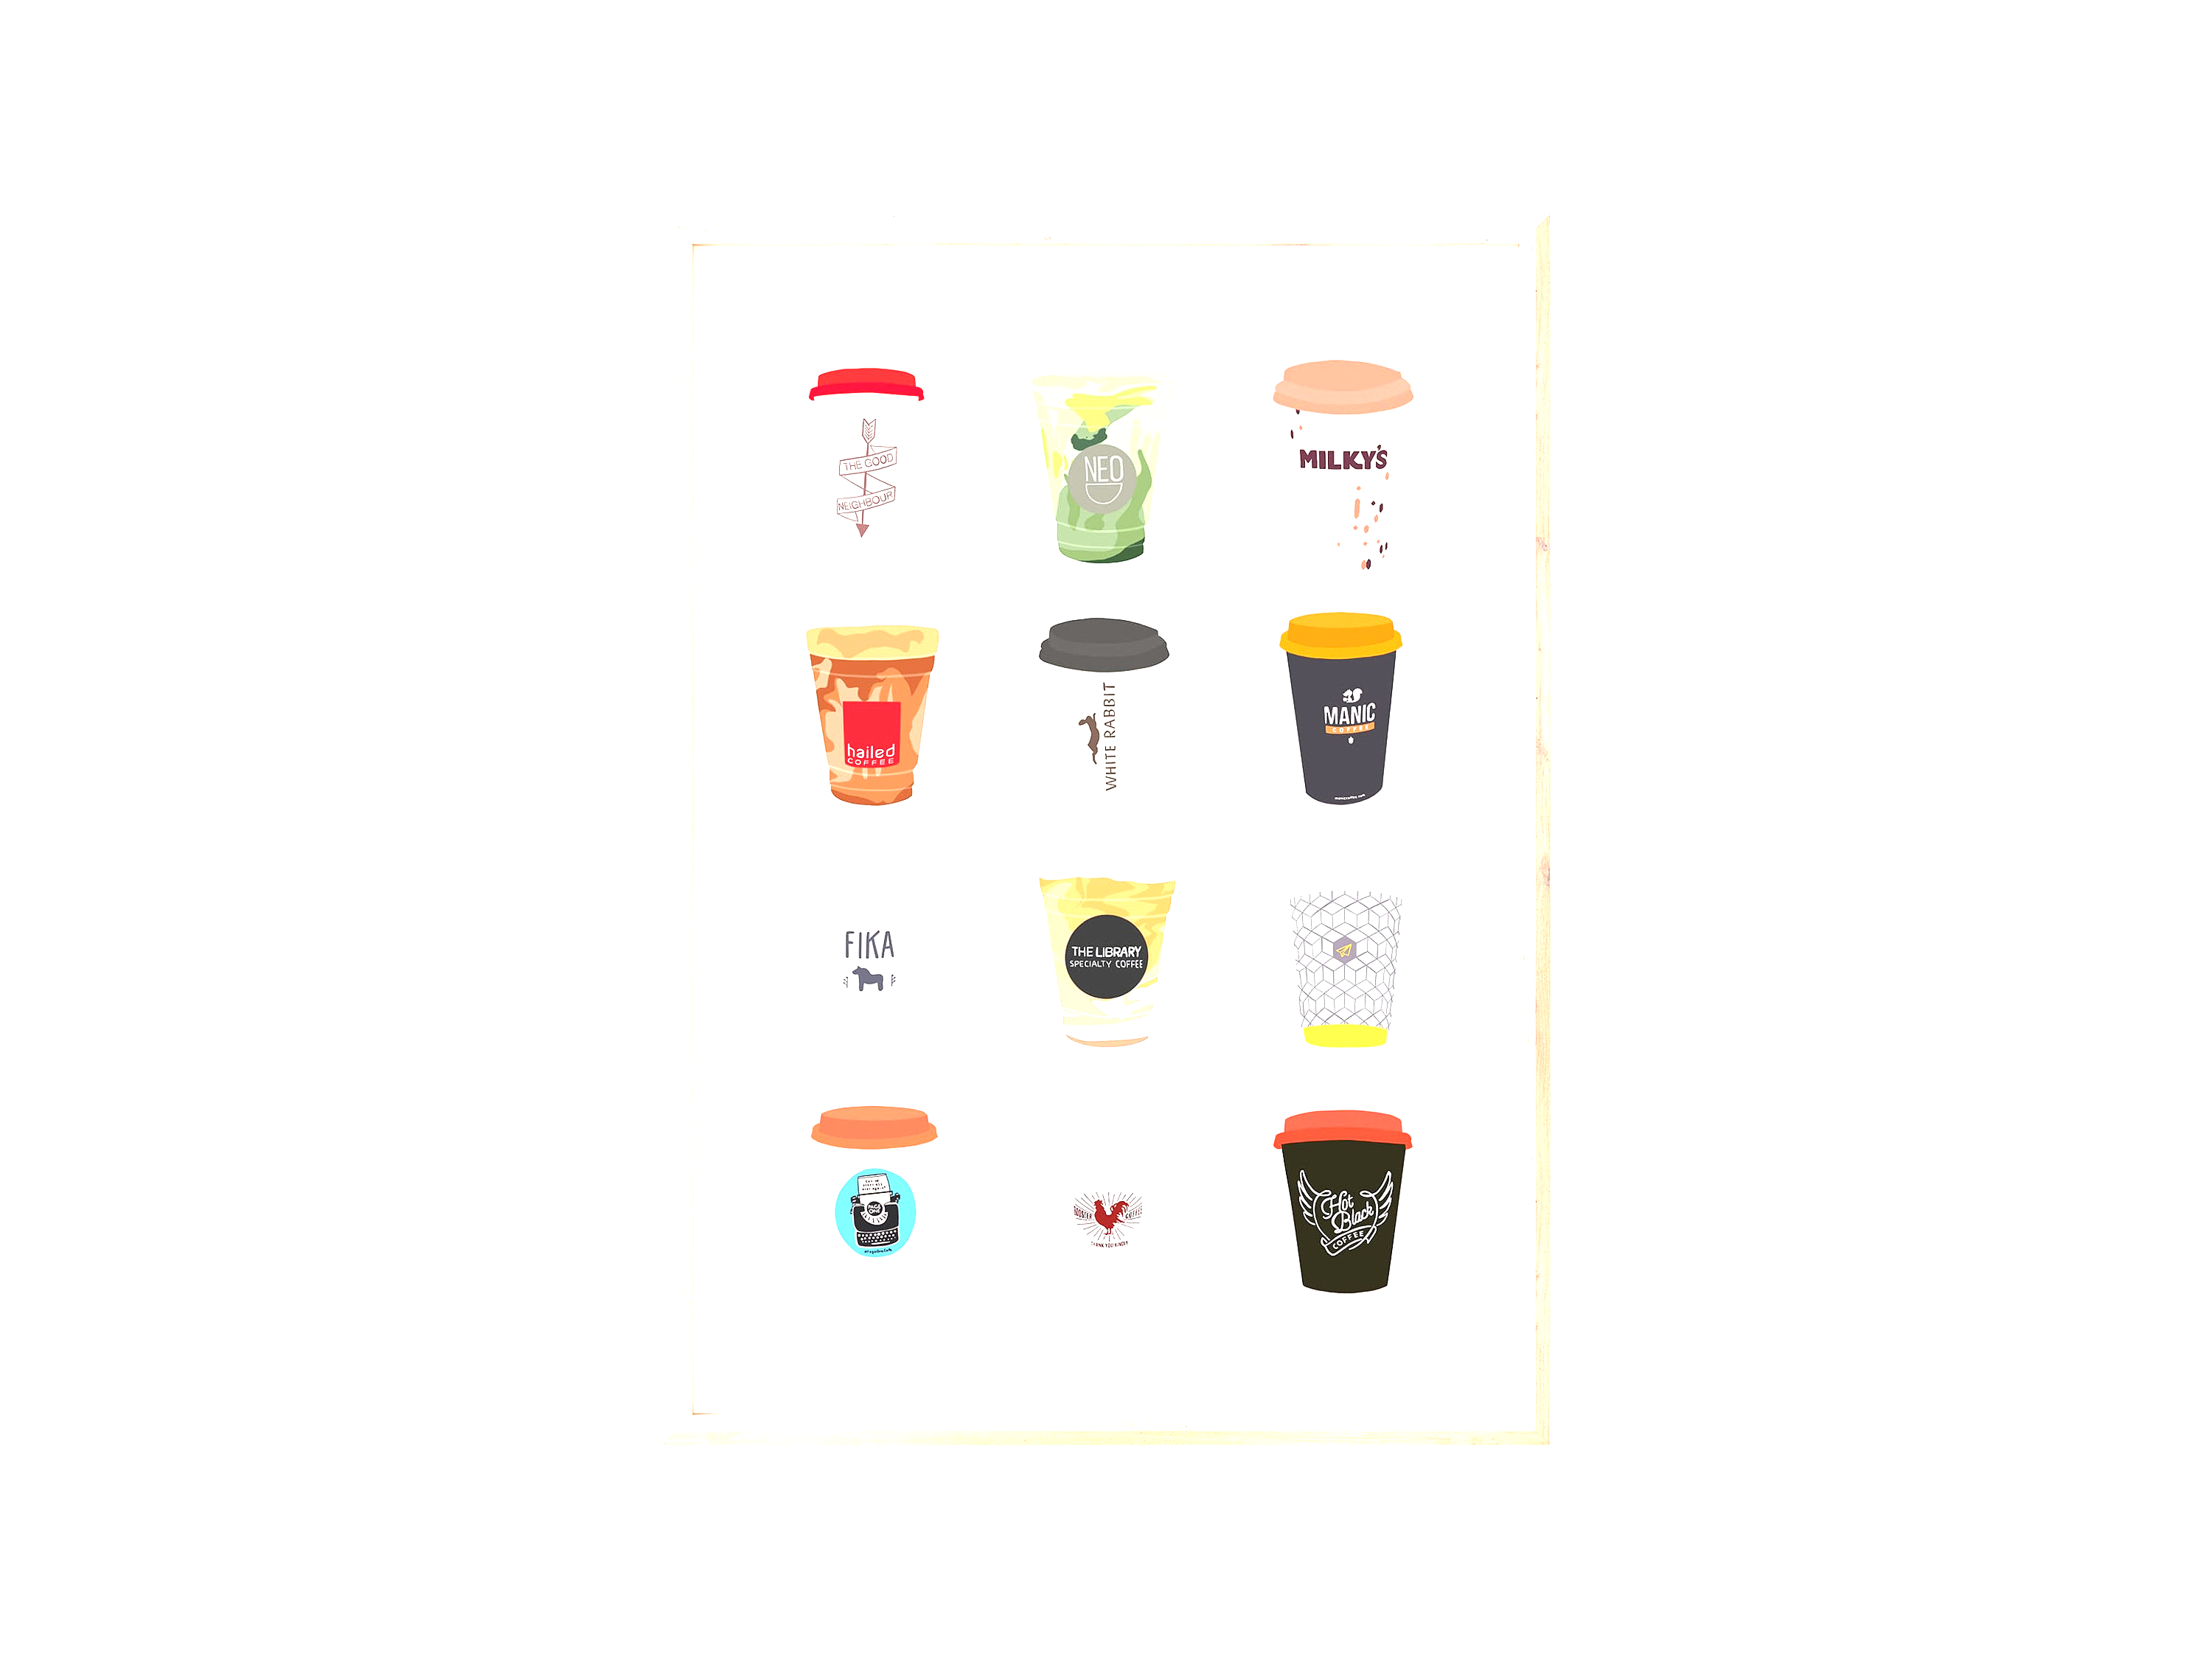
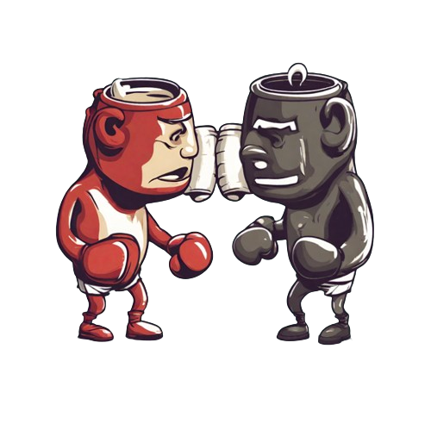
DAVID’s Coffea
To Energize the Vim and Vigorous Lives of the Modern Day Urbanite, Who Yearns For the Innovative, Sustainable and Sophisticated Blends of Canadian Approved Flavours at Superior Quality
DAVID’s COFEA

Slide 6
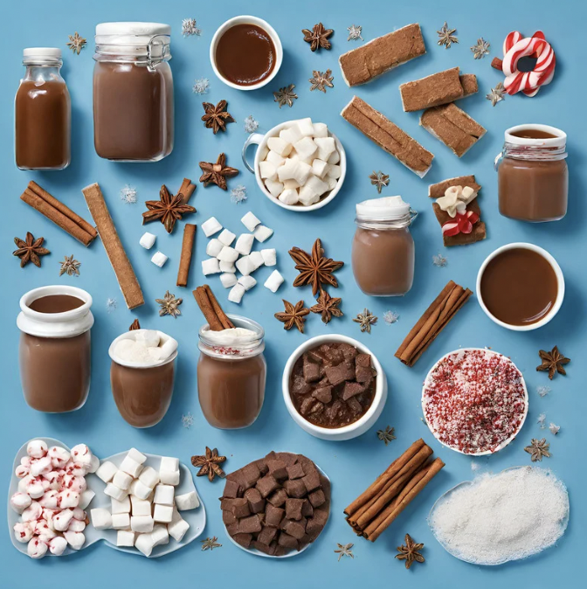
Generic coffee
competiton
DAVID’s COFEA

Slide 7

New Product Line
By David’s coffee
DAVID’s COFEA
Fall 2024
PEPPERMINT MOCHA
MARSHMALLOWS
CANDY CANE
SPRINKLES
HOT CHOCOLATE

Slide 8

Candy Cane Crush
PEPPERMINT MOCHA
MARSHMALLOWS
CANDY CANE
SPRINKLES
HOT CHOCOLATE
DAVID’s COFEA
DRIED GINGERBREAD BITS
CINNAMON SUGAR

Slide 9

Night at Grandma’s
DRIED GINGERBREAD BITS
CINNAMON SUGAR
DAVID’s COFEA
DRIED APPLE
MAPLE SYRUP CARAMEL
CINNAMON STICKS

Slide 10
Warm Canadian Winter
DRIED APPLE
MAPLE SYRUP CARAMEL
CINNAMON STICKS
DAVID’s COFEA

Slide 11


Slide 12
25 Cad

Slide 13
Enviromental Climate
Social/Culture
Economic
Technology
Political/Legal
Gen Z + Millennial values sustainability; brands must align with this.
Social influences drive eco-conscious choices.
DavidsCoffea benefits from understanding cultural roles in coffee consumption.
Respecting cultural diversity is crucial in advertising
COVID-19 shifts coffee consumption to in-home
coffee consumption steady; 71% drink more coffee than tap water (June 2023).
High inflation raises coffee business costs; pressures for affordable options.
Potential recession may impact premium coffee sales negatively.
Coffee market projected to grow
Traditional: hydrolysis and extraction
New method: freeze-drying preserves natural flavor better.
Production method choice impacts flavor quality.
Cost consideration: freeze-drying machines expensive; in-house feasibility questioned.
Canadian Foods and Drugs Act, specifying coffee bean types and production standards.
Limits on caffeine, requiring accurate labeling in French and English.
Compliance with Competition Bureau for accurate advertising and Trademarks Act for brand protection.
Ethical sourcing and FairTrade in Latin America.
Import accessibility: Raw coffee beans exempt from taxes and tariffs

Slide 14
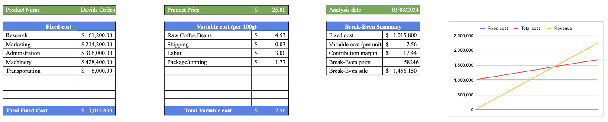
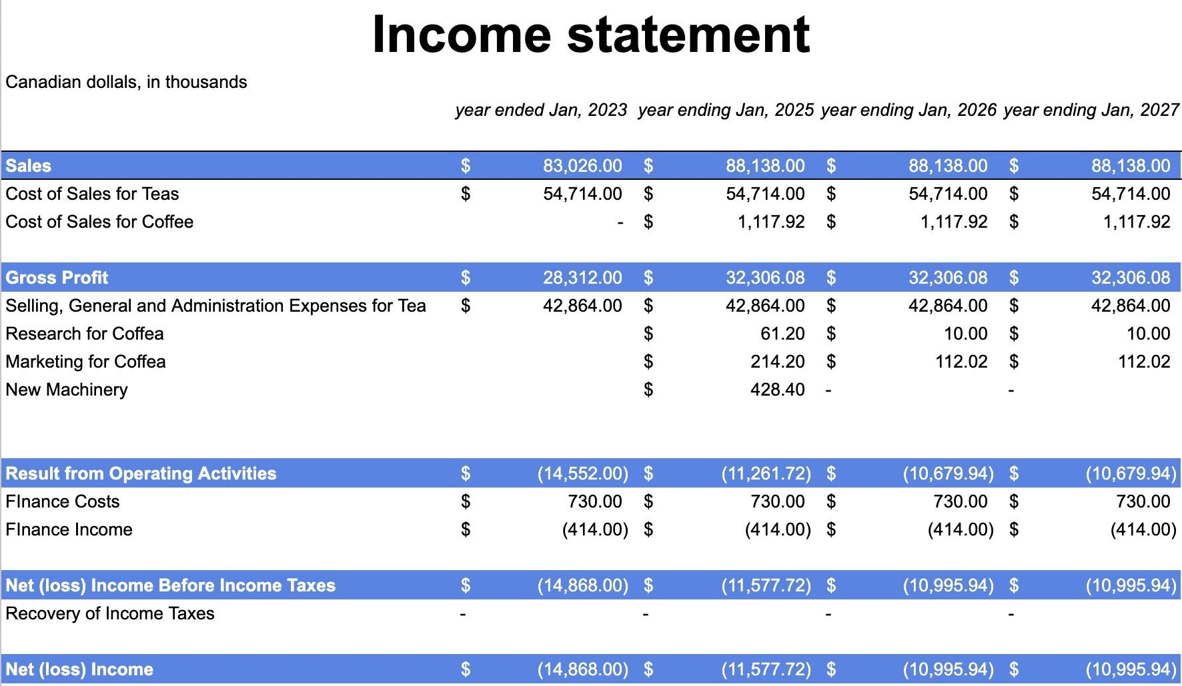
Income Statement + Break Even Analysis
$583,000 profit solely from Davids Coffea
BEA 58,246 sales
$191,411.21 marketing budget
Davids Coffee will positively impact our income statement, reduce net loss

Slide 15
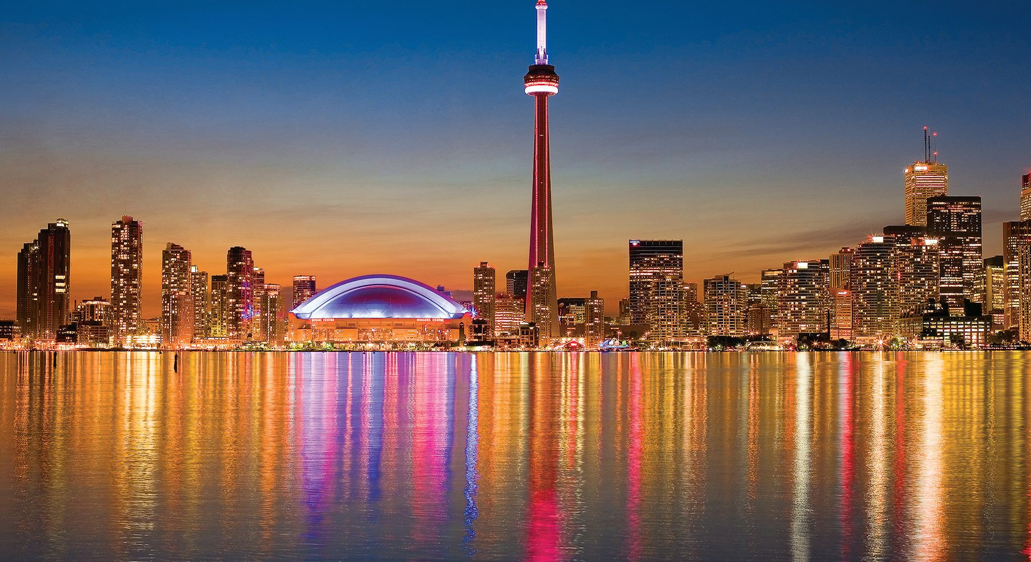
Thank You For Listening!

